Slide 1
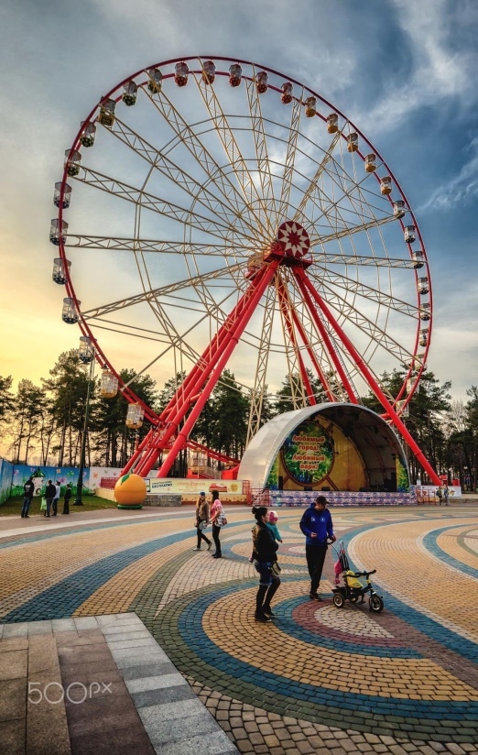
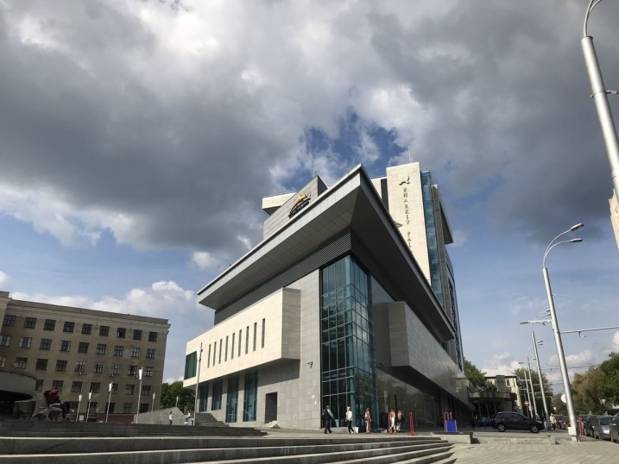
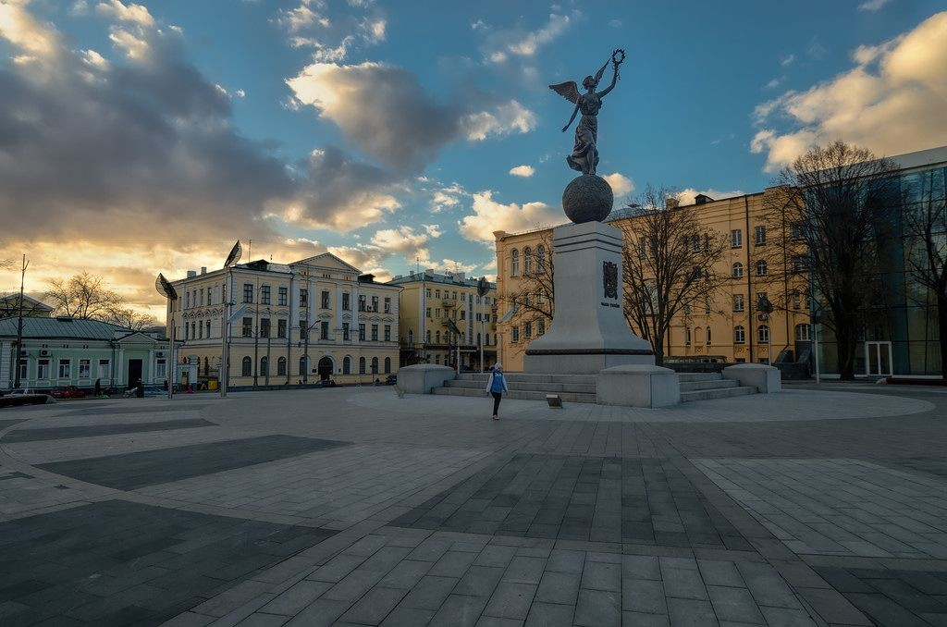
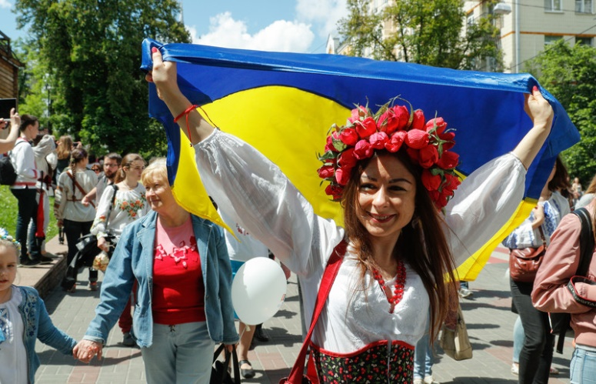
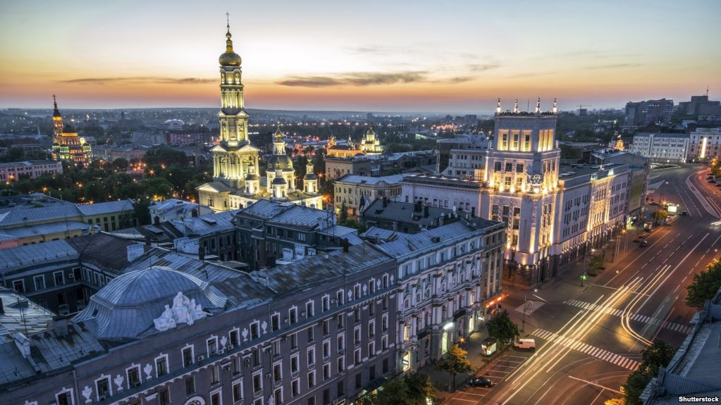
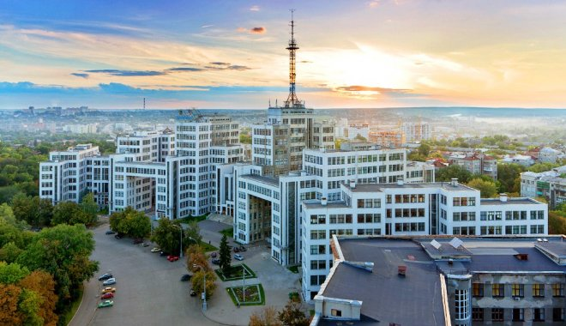
Kharkiv, Ukraine

Slide 2
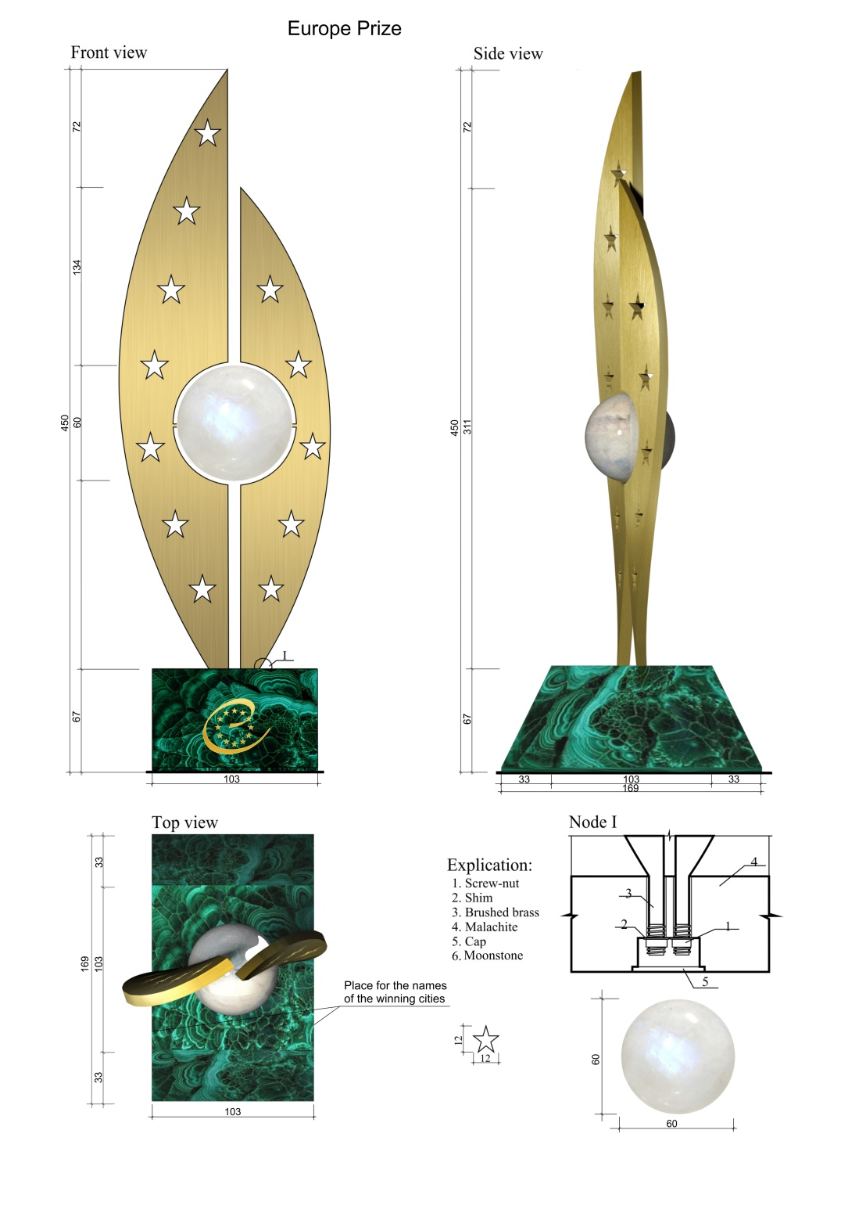
Concept
two metal plates resemble a natural leaf shape
the plates are made in the form of
wings with the idea of breath-taking
freedom
spherical center personifies the Council of Europe spirit, integrity, common interests, aspiration for peace and well-being
trapezoid pedestal symbolizes fertile and solid ground for further development
12 stars symbolize excellence, independence and justice
Forms reflect the spirit of unity and symbolize Europe

Slide 3
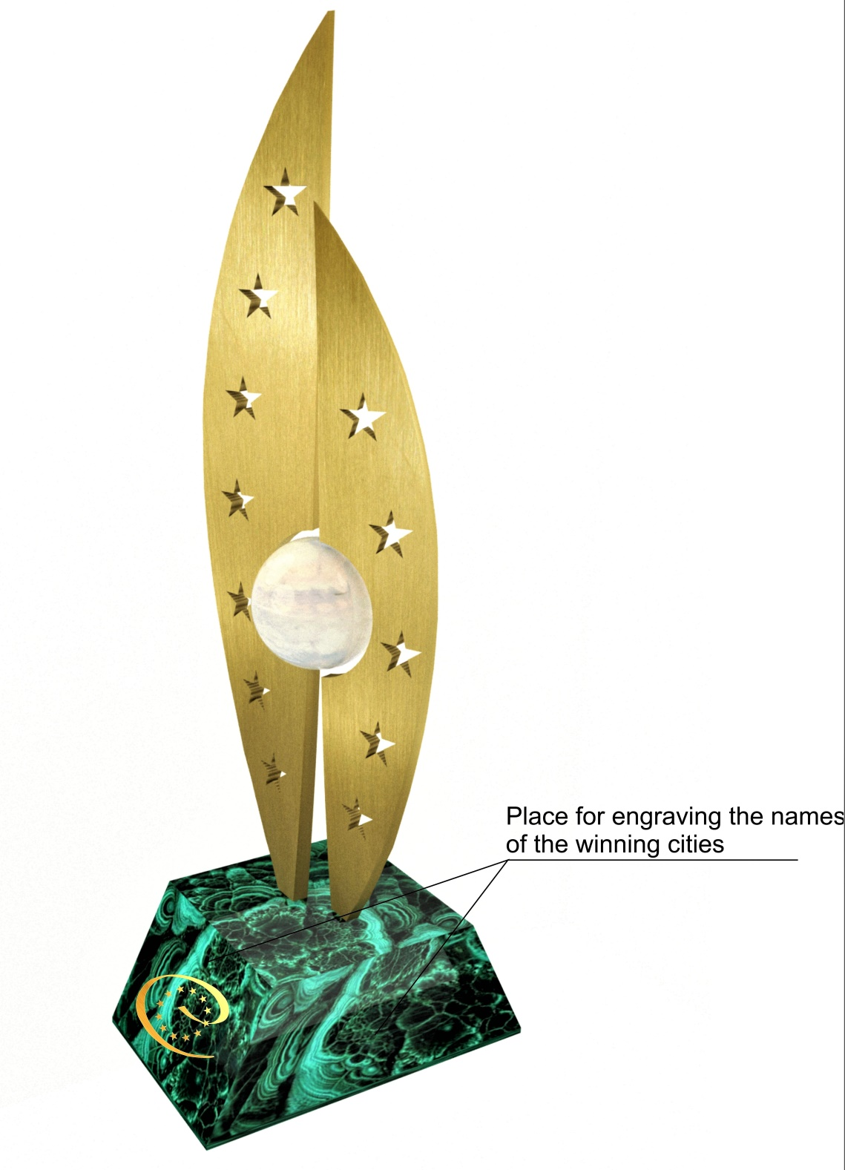
Main components
a pedestal with the Council of Europe logo on it, space intended for the names of winning cities
two metal plates
a sphere between them

Slide 4
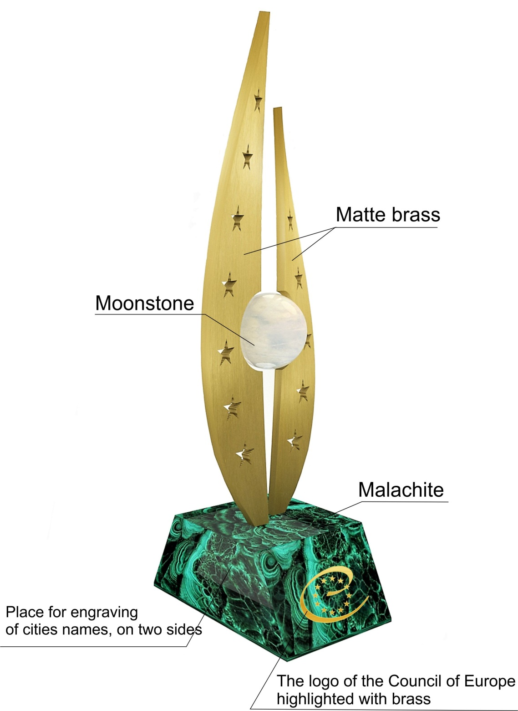
Materials
The pedestal is made of malachite, on which the logo of the Council of Europe is engraved front and back.
The engraving is highlighted with brass.
The names of cities will be engraved on the other two sides of the pedestal and highlighted with gold leaf
The metal plates are made of matte brass, in which 12 stars are carved
The sphere is made of moonstone

Slide 5
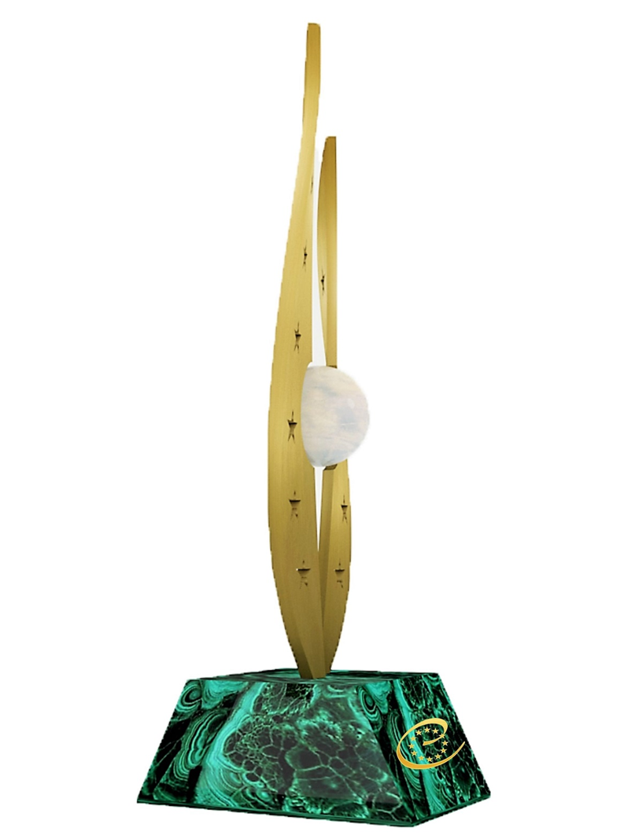
Europe Prize Mini Europe Prize
Dimensions:
450 mm * 169 mm * 103 mm
Weight:
6 kilograms
Cost:
1000 euros
Dimensions:
200 mm * 75 mm * 45 mm
Weight:
3 kilograms
Cost:
500 euros

Slide 6
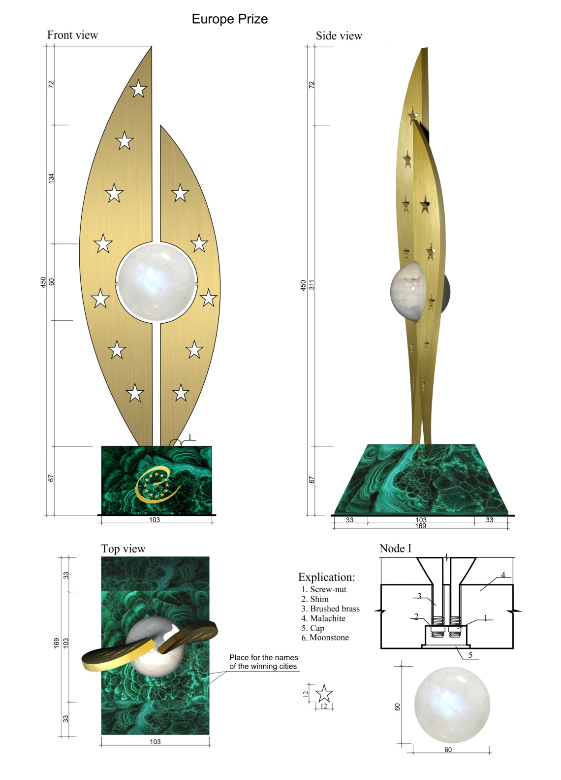
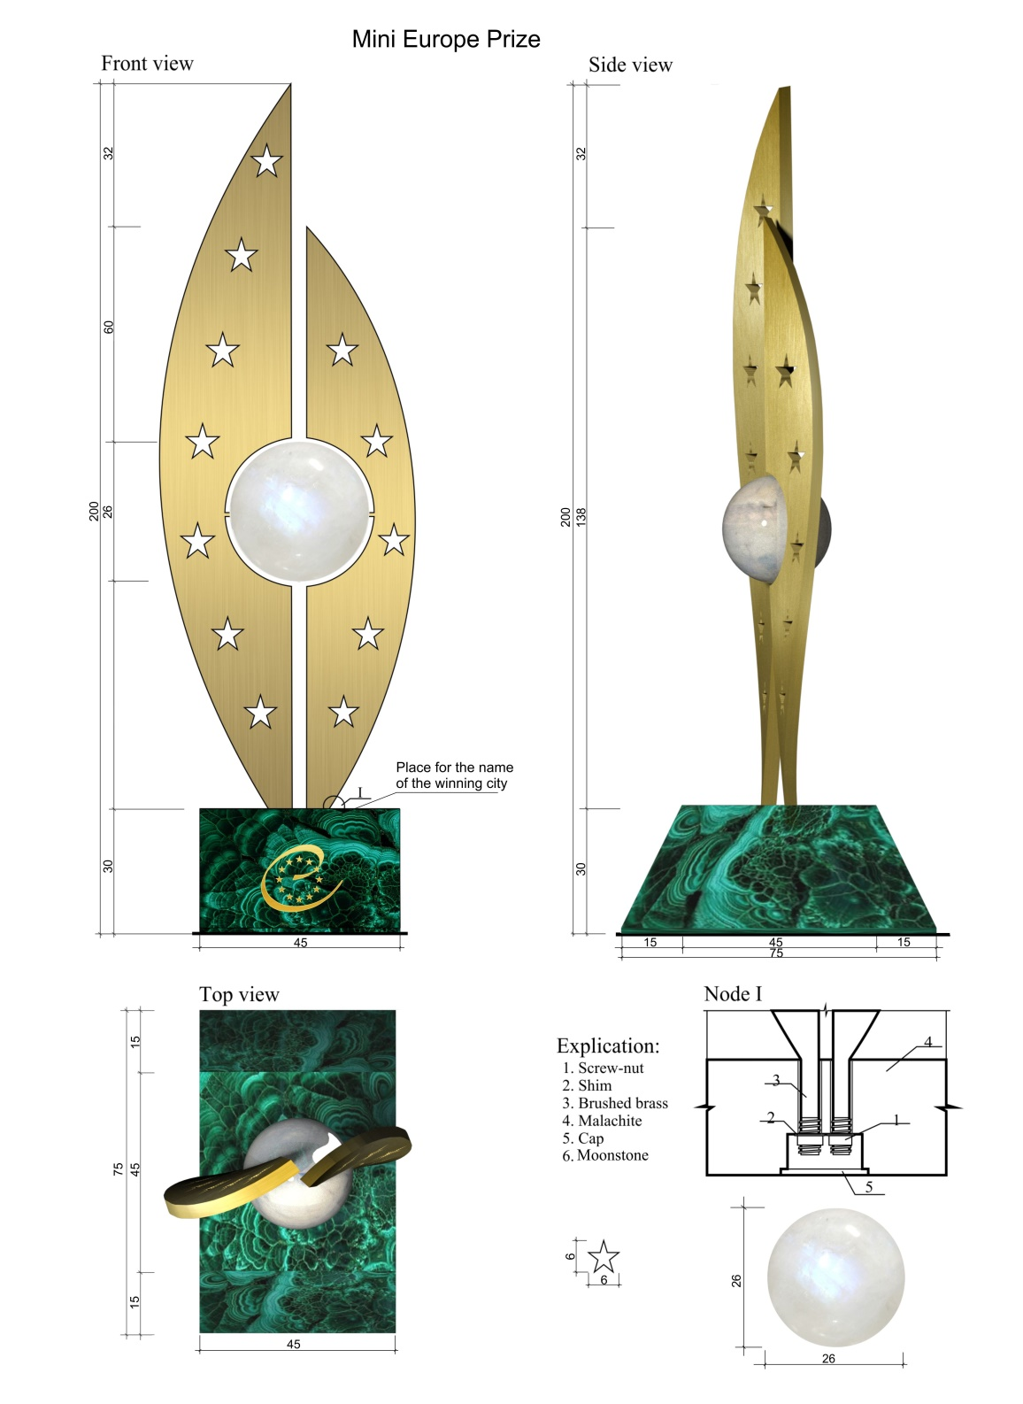

Slide 7
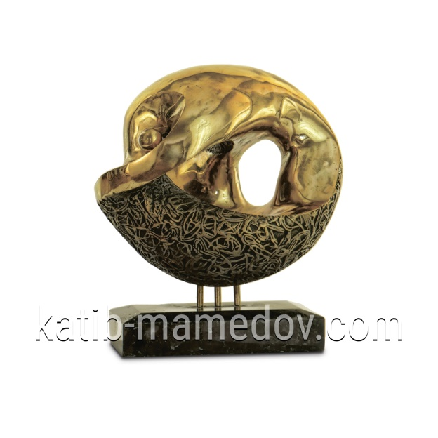
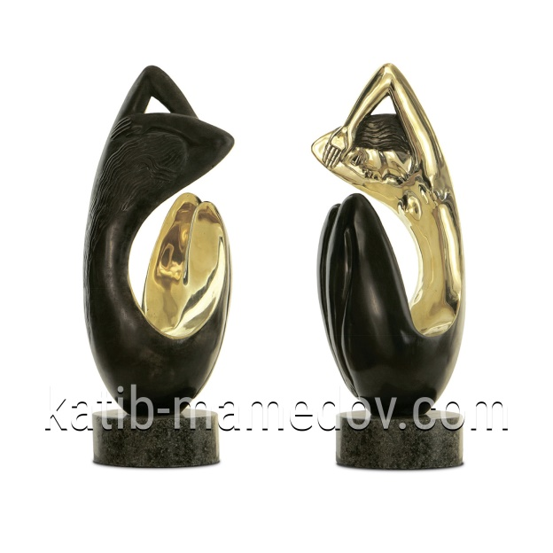
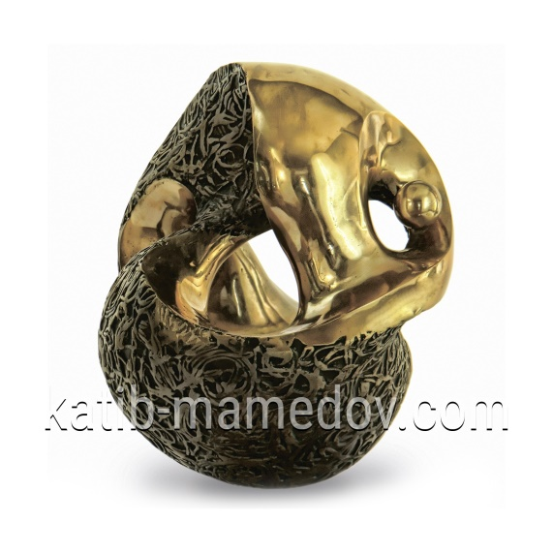
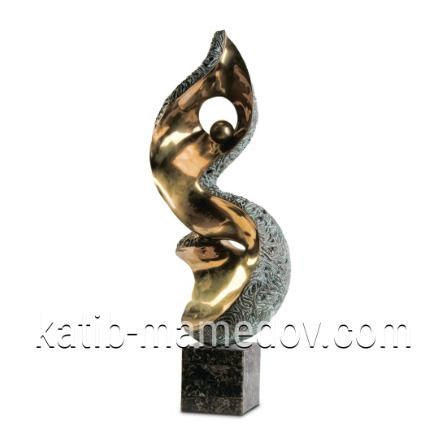
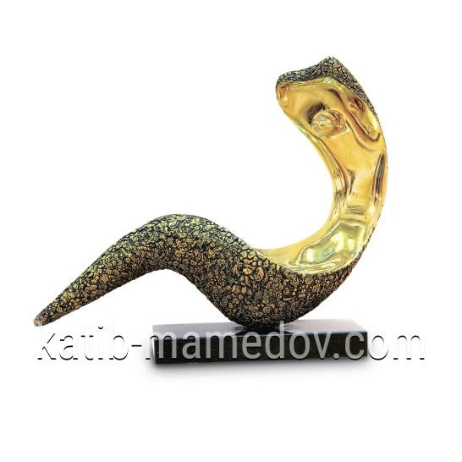
Manufacturer
The manufacturer of the new Europe Prize is the creative workshop of the Kharkiv artist and sculptor Katib Mamedov http://katibmamedov.com/

Slide 8
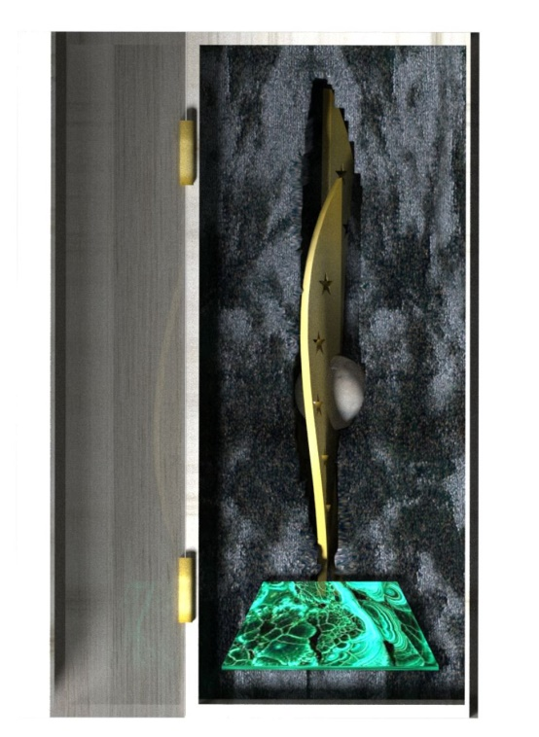
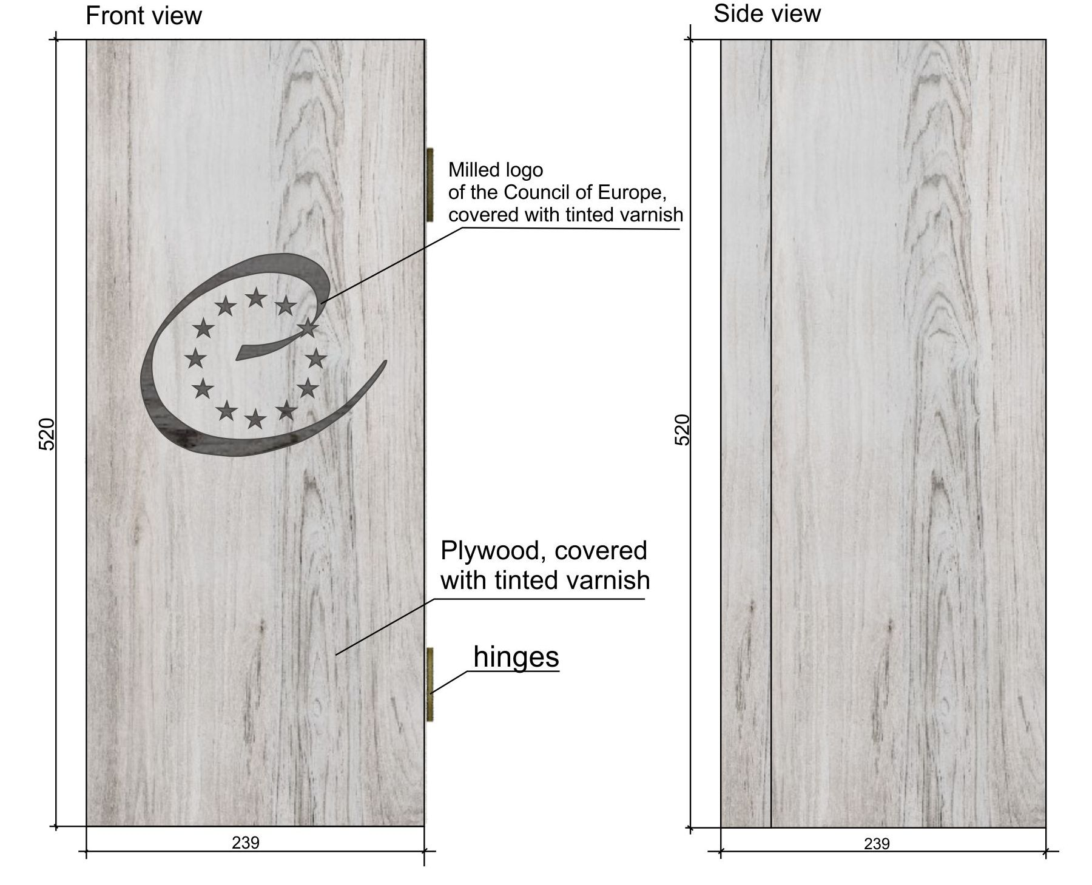
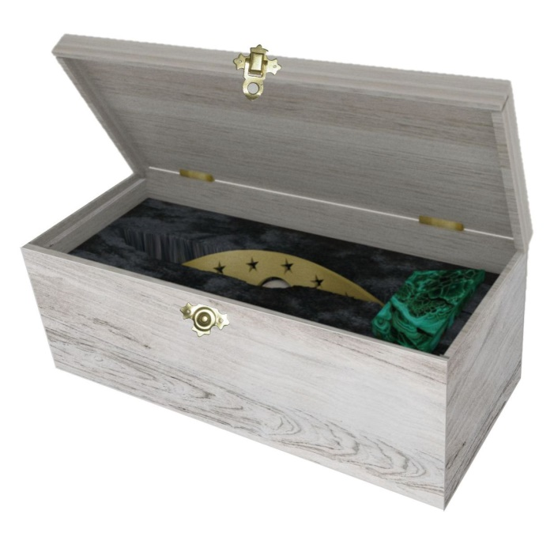
Protective Case

Slide 9
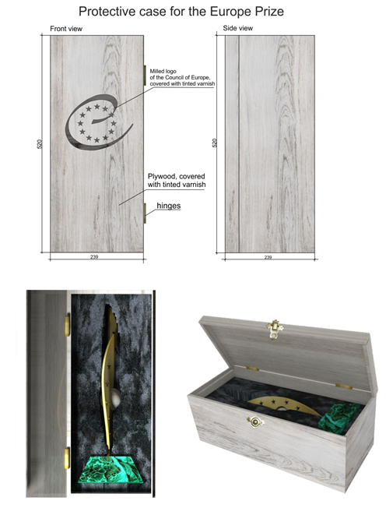
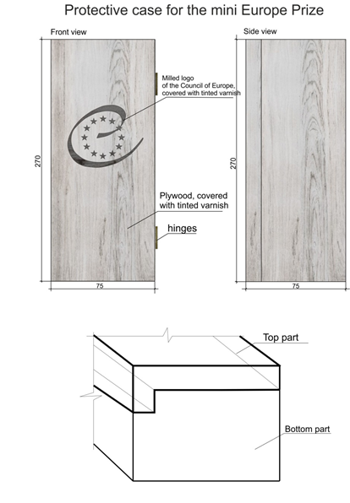
Dimensions:
520 mm * 239 mm * 173 mm
Weight:
1 kilogram
Cost:
40 euros
Dimensions:
270 mm * 145 mm * 115 mm
Weight:
600 grams
Cost:
20 euros

Slide 10
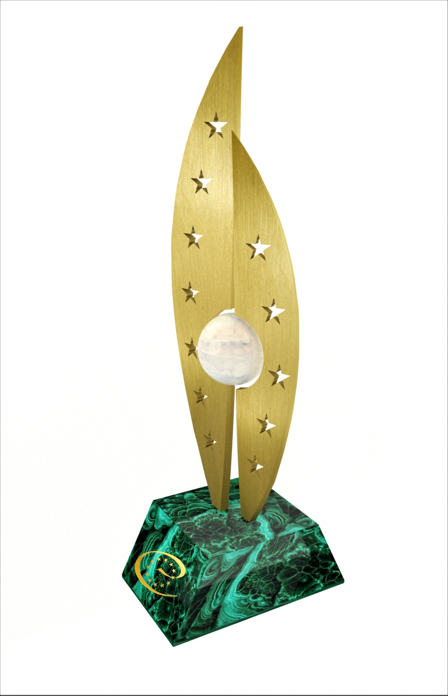
Thank you for your attention!

